Slide 1
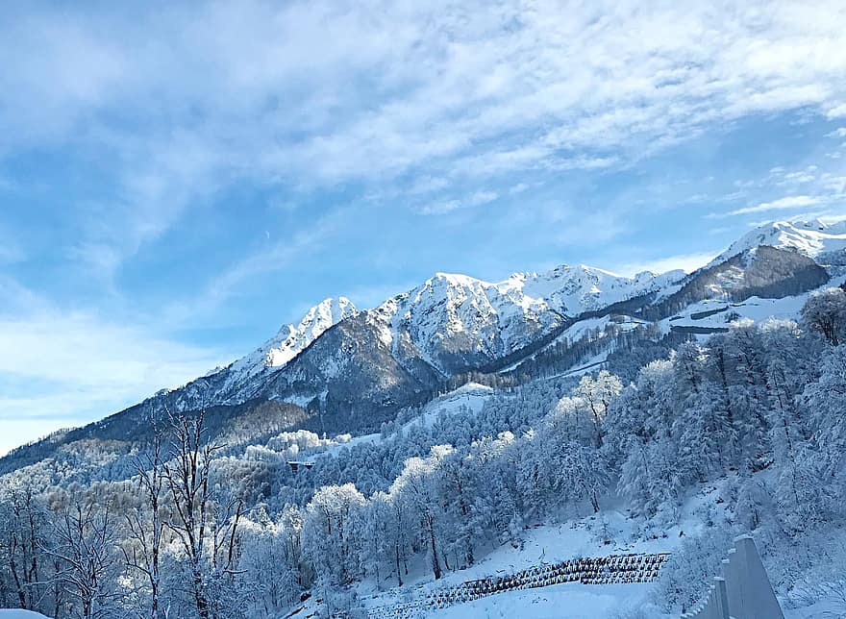
Big Mountain Ski Resort
Asset Value And Ticket Price Analysis

Slide 2
Where We Stand
One of 12 resorts in the state of Montana
One of 330 nationally in our market segment
350,000 Visitors Per Year
Average Stay of 5 Days
Adult Ticket Price of $81
Current Pricing Strategy Lacks Granularity
New Lift Operating Cost Of $1,540,000
Desire To Increase Revenue and Reduce Operating Costs

Slide 3
Current Facilities
2353 Foot Vertical Drop
105 Trail Runs
Longest Trail Run of 3.3 Miles
14 Chair Lifts Total
3 Fast Quad Chair Lifts
600 Acres of Snow Machine Covered Terrain
3000 Acres of Skiable Terrain

Slide 4
Findings
Based on Facilities Ticket Price Is Too Low
Projected Ticket Price Of $94.22
$22.5 Million Increase In Revenue Including New Lift Operating Cost
Most Valuable Assets
Vertical Drop
Snow Machine Covered Acerage
Trail Runs
Fast Quad Chair Lifts
Focus on Vertical Drop & Closing No More Than 5 Trail Runs
Scenario 1 - Close Trail Runs. 1 - No Effect. 3-5, same effect on Price.
Scenario 2 - Add 150ft of drop, 1 Run & 1 Lift. Additional Ticket Price Increase of $2.29, $2,467,246 In Yearly Revenue

Slide 5

Scenario Analysis
Decrease In Revenue Correlated To Closed Trail Runs
1 Has No Effect
3-5 Same Decrease
6 & Greater Prohibitive Revenue Drop

Slide 6

Feature Analysis
Features most correlated to ticket price
Fast Quads
Trail Runs
Snow Making Acerage
Vertical Drop
Skiable Terrain
Total Chairs

Slide 7

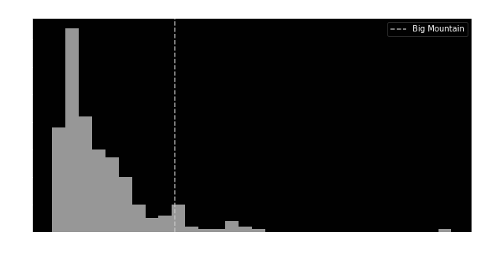
Price Analysis
Market Leading
Trail Runs
Fast Quads

Slide 8
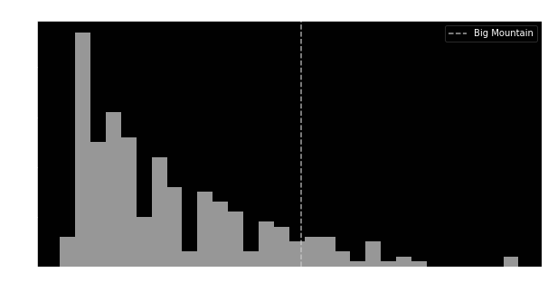
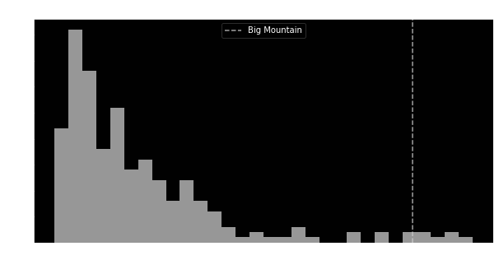
Price Analysis Cont.
Market Leading
Total Vertical Drop
Area Covered By Snow Makers

Slide 9
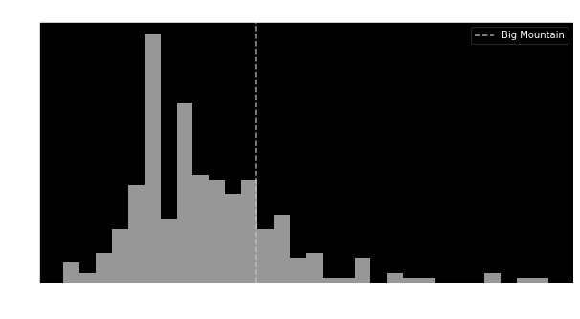
Price Analysis Cont.
Ticket Price Current vs. Predicted Relative To Market

Slide 10
Summary
Predicted Ticket Price of $94.22 Based On Current Facilities
Increased Yearly Revenue Of $21,595,000 Including New Lift Costs
Most Valuable Features
Fast Quad Chair Lifts
Total Vertical Drop
Number of Trail Runs
Area Covered By Snow Makers
Most Lucrative Scenarios, 1 & 2
Closing More Than 5 Trail Runs Would Have A Large Impact on Ticket Price
Adding Additional Trail Run That Adds 150ft To Total Drop & Additional Lift Could Increase Predicted Ticket Price By $2.29

